Slide 1
MFG 598 ENGINEERING COMPUTING WITH PYTHON FINAL PROJECT
WATER COMPANY SUBSCRIBER DATA ANALYSIS
ASEMAN ERFANI JAZI 1231818200

Slide 2
Project analysis slide 2
Machine Learning Algorithms
Python Project
Data Understanding and Pre-processing
Results
Classification
Evaluation

Slide 3

Project analysis slide 2
The Problem
Tehran is the most populated city in Iran, which can make the supply of sufficient water resources for this city face a crisis.
In this case, the management of regional water resources faces challenges, such as water shortage and the increasing growth of water demand. Therefore, this Project focuses on investigating the behavior of subscribers to support the planning and management of water resources. In this way, by using the available data, these models classify the subscribers in terms of consumption. Machine learning methods are used to build these classification models.

Slide 4





Project analysis slide 2
Proposed model
Data Understanding
Pre-processing
Feature Engineering
Modeling
Evaluation

Slide 5
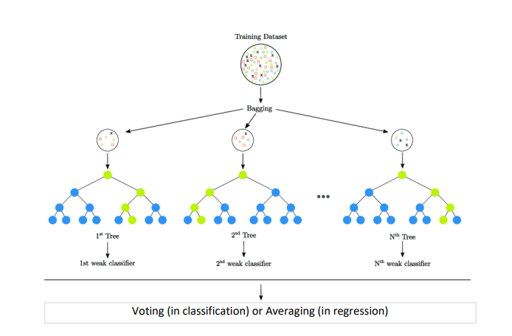
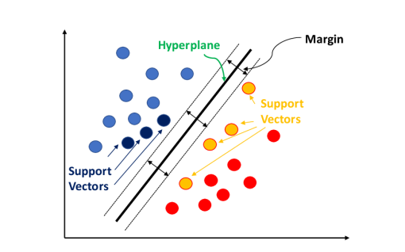
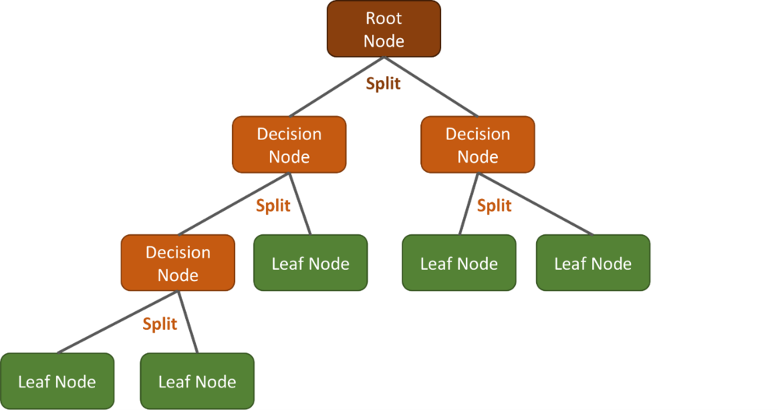
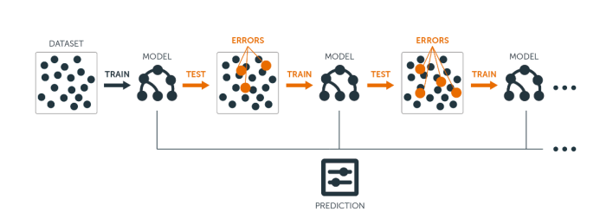
Machine Learning algorithm
used in this project
Classification and Regression Trees (CART)
Random Forest (RF)
Support Vector Machine (SVM)
Gradient Boosting (GB)

Slide 6
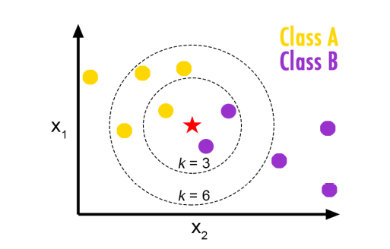
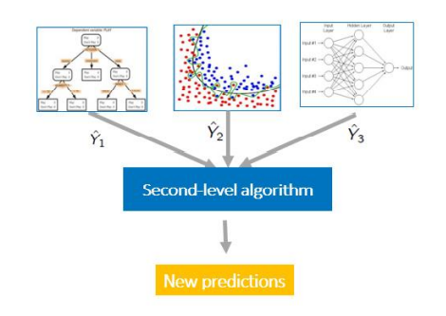
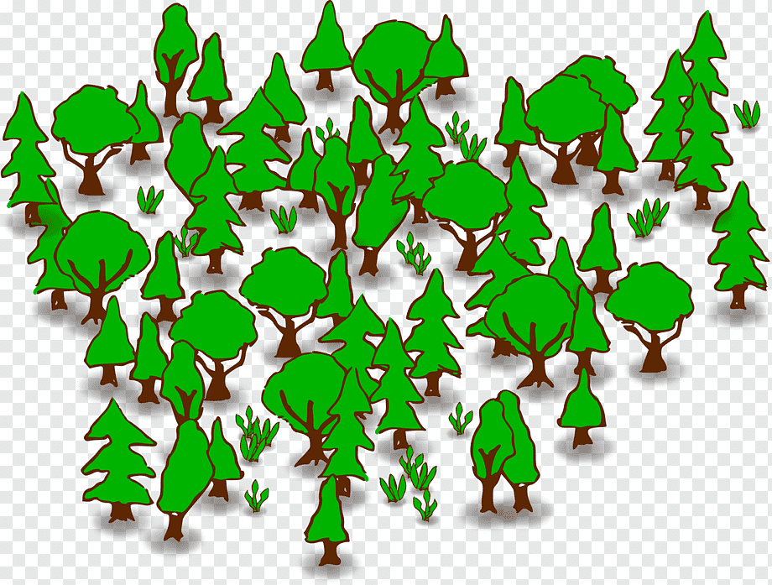
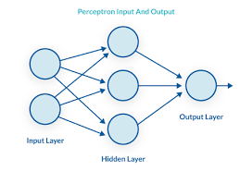
Machine Learning algorithm
used in this project
K-Nearest Neighbors (KNN)
Stacking
Extremly Randomized Trees (Extra Tree (ET))
Multilayer Perceptron (MLP)

Slide 7
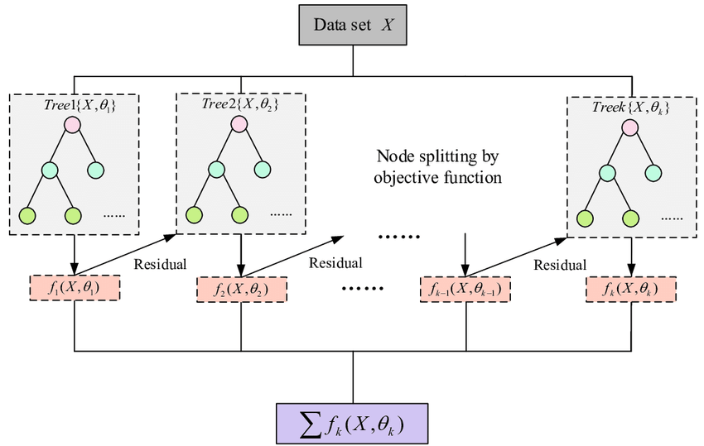
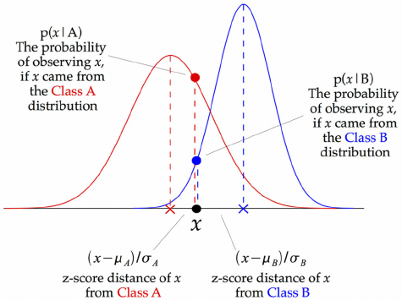
Machine Learning algorithm
used in this project
XGBClassifier (XGBC)
. Gaussian Naïve Bayes (GNB)

Slide 8
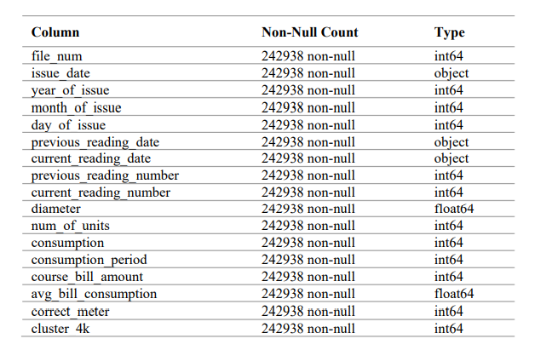
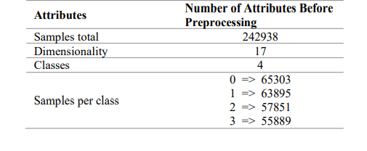
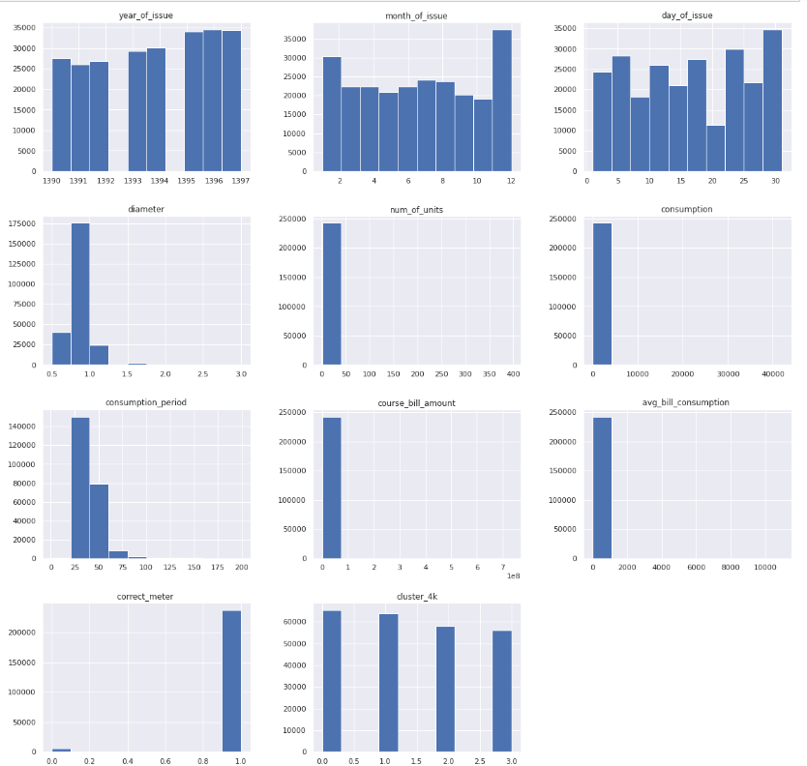
Project analysis slide 2
Data understanding
Cleaned data histograms

Slide 9

Project analysis slide 2
Pre-processing
As the first step in data preprocessing, we removed the following features: file_num, issue_date, previous_reading_date, current_reading_date, previous_reading_number, current_reading_number, and diameter because these features were redundant. For example, the consumption feature gives us complete information about the amount of consumption, and we will no longer need previous_reading_number and current_reading_number. Also, the consumption_period field eliminates our need for current_reading_date fields. On the other hand, the same can be done for issue_date.

Slide 10
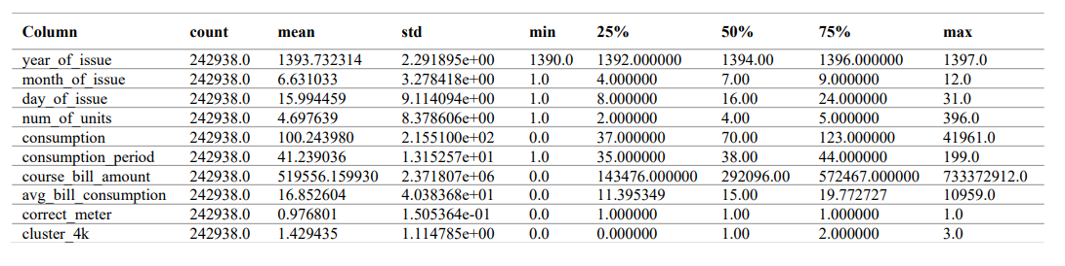
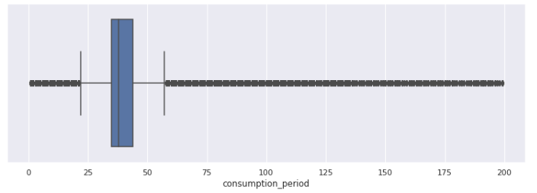
Project analysis slide 2
Pre-processing
(outlier management)
Statistical Analysis
we first examine the distribution of each feature, and since they have an abnormal distribution, we use the IQR method and
the boxplot diagram to manage the outlier data .
we replace the out-of-bounds data in the chart with a value of Q3 + (1.5 * IQR) and those before the low limit position in the chart with a value of Q1- (1.5 * IQR). There is also no missing data in this dataset.
Sample of box plot

Slide 11
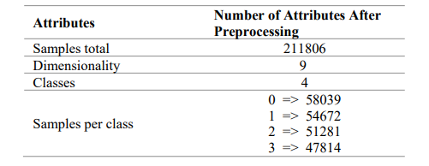

Project analysis slide 2
Pre-processing
(duplicate data removing)
So, we proceed to delete duplicate data. At this point, by examining the dataset in terms of duplicate instances, we find that we have 31132 duplicate instances, and since we know our case is balanced, we remove the duplicate data.

Slide 12
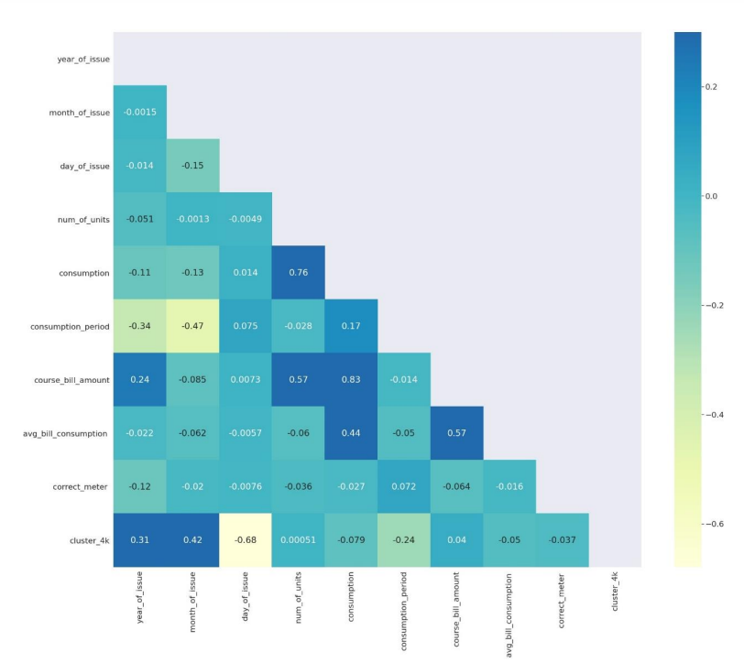
Project analysis slide 2
Correlation between dataset features
The Figure shows the correlation between the features and the target feature after performing the preprocessing steps.

Slide 13

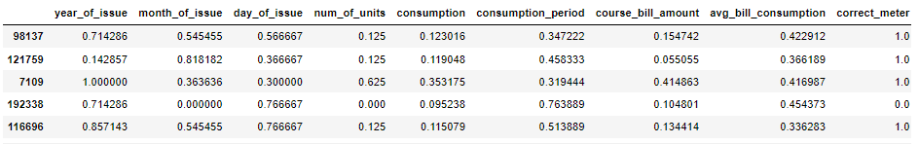
Project analysis slide 2
Normalization
I separated the target feature and split the data at a ratio of 70% and 30% for training and testing data, respectively.
Then we normalized the training and test data with the help of a min max- scalar so that the range of values ​​of all features is between 0 and 1

Slide 14
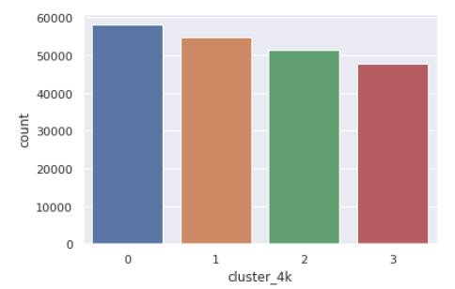
Project analysis slide 2
مدل سازی
In order to implement the selected classification algorithms, we divided the data into 2 training and testing parts, and our target feature is Cluster_4k, which contains the labels obtained from the clustering results and has 4 classes.
The number of samples in each cluster in the Cluster_4k column, which is our target attribute, is as follows

Slide 15
Project analysis slide 8
Confusion matrix
PREDICTED CLASS
POSITIVE
NEGATIVE
POSITIVE
True Positive (TP)
False Negative (FN)
ACTUAL CLASS
NEGATIVE
False Positive (FP)
True Negative (TN)

Slide 16
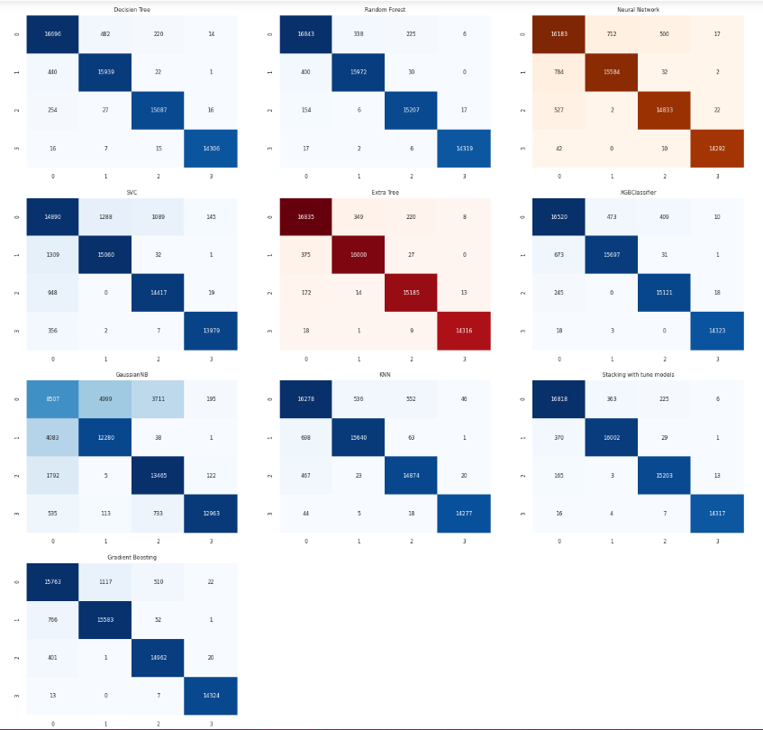
Project analysis slide 3
Confusion matrix
We use the recall, precision accuracy, and F-measure metrics to evaluate the constructed models. These metrics can be easily understood and calculated using the confusion matrix. Figure shows an image of the confusion matrix. As shown, there are metrics in the cells of this matrix, each of which has its meaning (in this case, the problem is a binary case with two classes of positive and negative)

Slide 17




Project analysis slide 3
Evaluation metric
Accuracy
Precision
Recall
F-measure

Slide 18
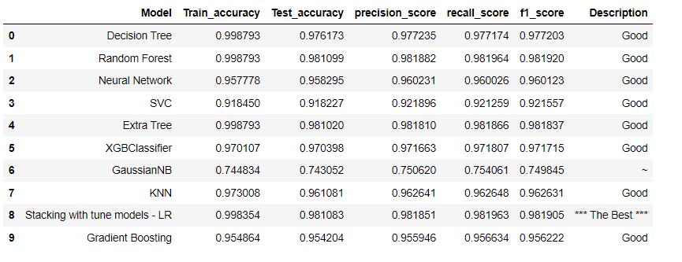

Project analysis slide 7
Results
The Stacking model exhibited the highest training and test accuracy, reaching 99% and 98%, respectively. Thus, it was chosen as the final model for this project.
%98

Slide 19
THE END

